Slide 1

WIPRO NGA Program – Datacenter Batch
Capstone Project Presentation – 06 April 2024
Project Title Here -
Presented by -
www.rpsconsulting.in

Slide 2
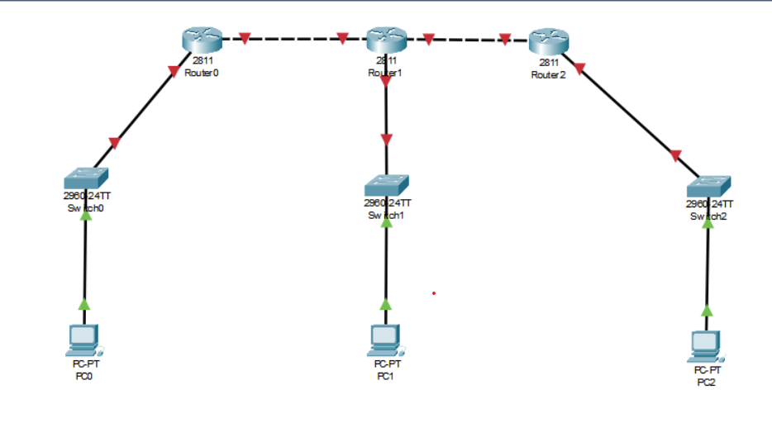

1.Static routing using 3 routers
Add the devices & connect them with appropriate wires
2024 - RPS Consulting all rights reserved

Slide 3
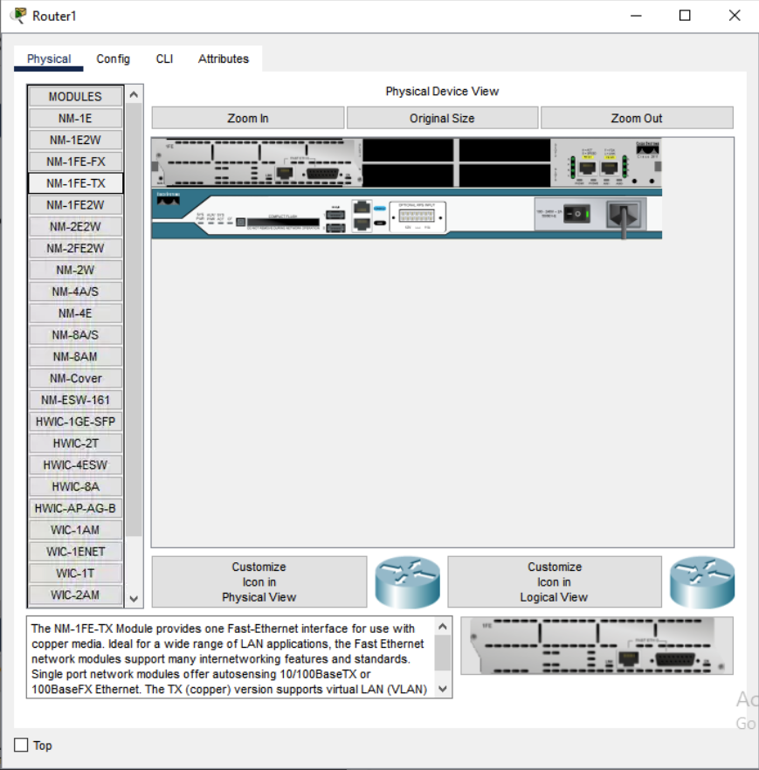
NOTE: As the used Router 2811 contains only 2 fast ethernet port we have to add another ethernet port to the router1 then only it will able to make 3 connections.
2024 - RPS Consulting all rights reserved

Slide 4
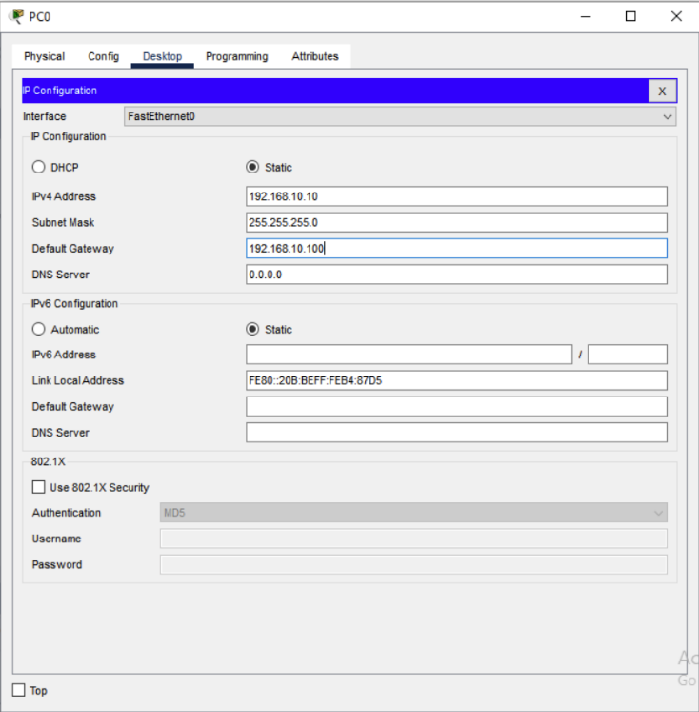
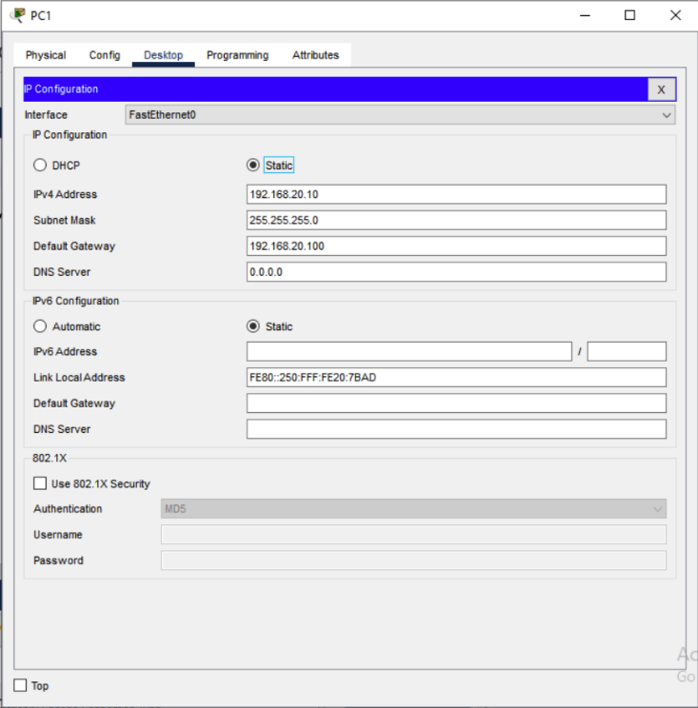
Configure IP address of each device
PCO: PC1:
2024 - RPS Consulting all rights reserved

Slide 5
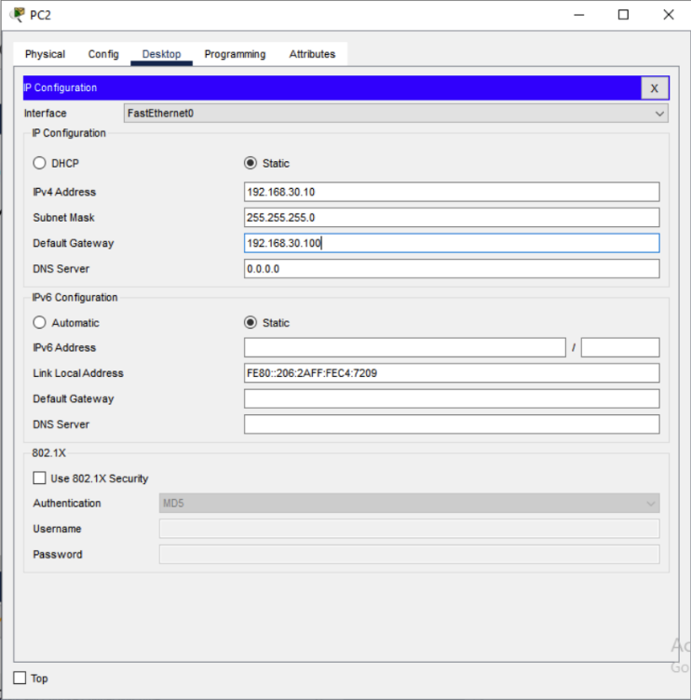
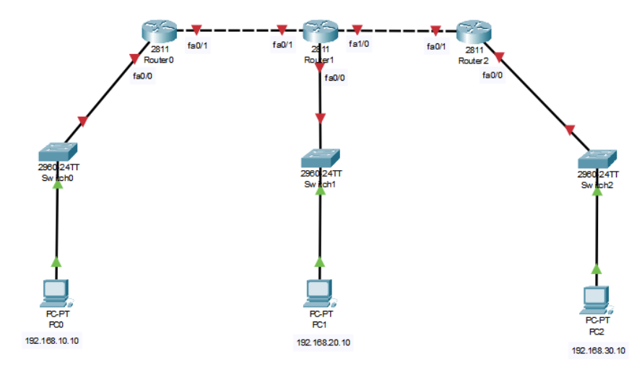
PC2:
2024 - RPS Consulting all rights reserved

Slide 6
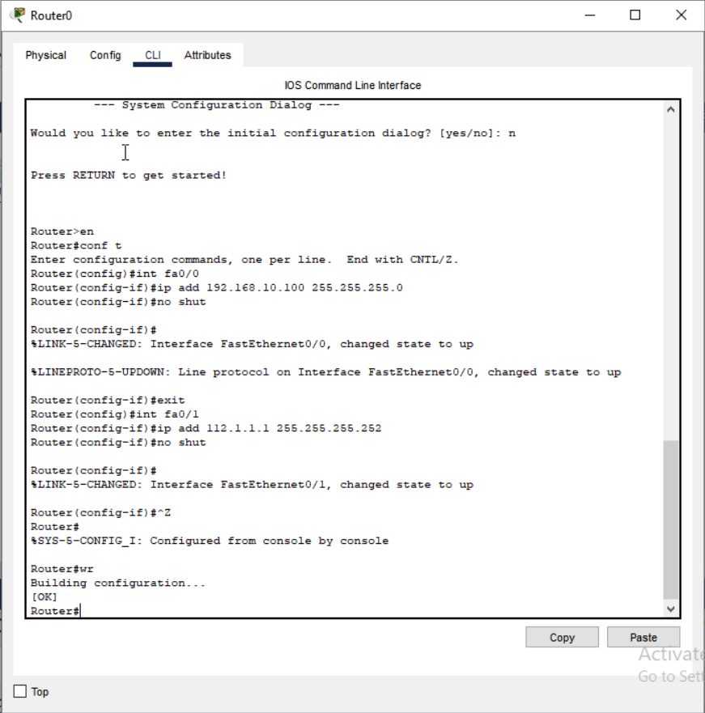
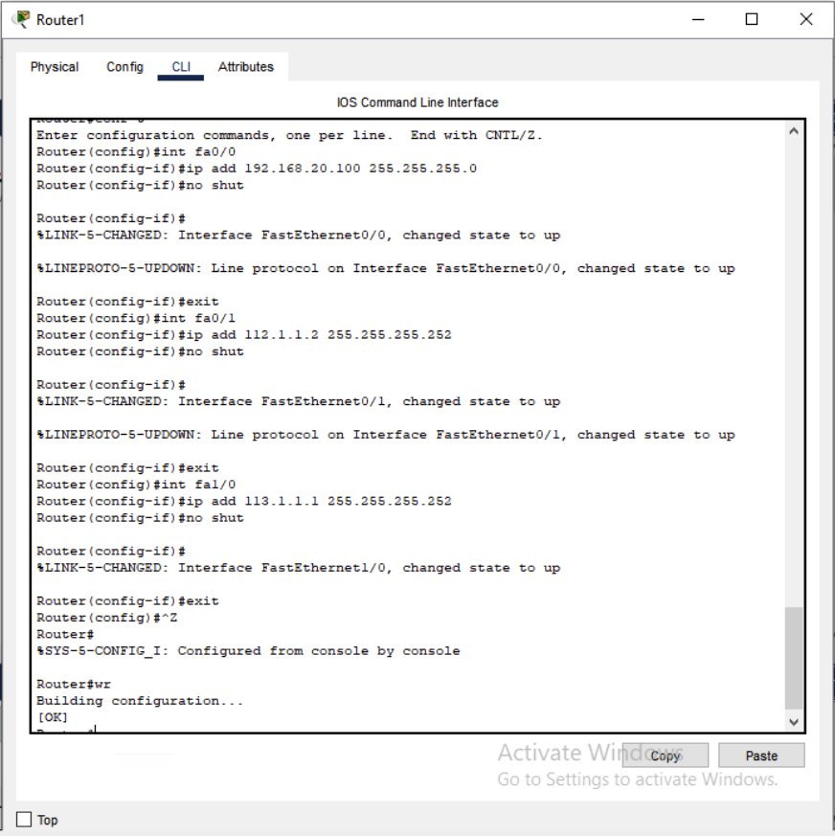
Configure all routers
Router0: Router1:
2024 - RPS Consulting all rights reserved

Slide 7
Slide Title
Slide details here
2024 - RPS Consulting all rights reserved

Slide 8
Slide Title
Slide details here
2024 - RPS Consulting all rights reserved

Slide 9
Slide Title
Slide details here
2024 - RPS Consulting all rights reserved

Slide 10
Slide Title
Slide details here
2024 - RPS Consulting all rights reserved

Slide 11
Slide Title
Slide details here
2024 - RPS Consulting all rights reserved

Slide 12
Slide Title
Slide details here
2024 - RPS Consulting all rights reserved

Slide 13
Slide Title
Slide details here
2024 - RPS Consulting all rights reserved

Slide 14
Slide Title
Slide details here
2024 - RPS Consulting all rights reserved

Slide 15
Slide Title
Slide details here
2024 - RPS Consulting all rights reserved

Slide 16
Slide Title
Slide details here
2024 - RPS Consulting all rights reserved

Slide 17
Slide Title
Slide details here
2024 - RPS Consulting all rights reserved

Slide 18
Slide Title
Slide details here
2024 - RPS Consulting all rights reserved

Slide 19
Slide Title
Slide details here
2024 - RPS Consulting all rights reserved

Slide 20
Slide Title
Slide details here
2024 - RPS Consulting all rights reserved

Slide 21
Slide Title
Slide details here
2024 - RPS Consulting all rights reserved

Slide 22
Slide Title
Slide details here
2024 - RPS Consulting all rights reserved

Slide 23
Slide Title
Slide details here
2024 - RPS Consulting all rights reserved

Slide 24
Slide Title
Slide details here
2024 - RPS Consulting all rights reserved

Slide 25
Slide Title
Slide details here
2024 - RPS Consulting all rights reserved

Slide 26
Slide Title
Slide details here
2024 - RPS Consulting all rights reserved

Slide 27
Slide Title
Slide details here
2024 - RPS Consulting all rights reserved

Slide 28
Slide Title
Slide details here
2024 - RPS Consulting all rights reserved

Slide 29
Slide Title
Slide details here
2024 - RPS Consulting all rights reserved

Slide 30
Slide Title
Slide details here
2024 - RPS Consulting all rights reserved

Slide 31
Slide Title
Slide details here
2024 - RPS Consulting all rights reserved

Slide 32
Slide Title
Slide details here
2024 - RPS Consulting all rights reserved

Slide 33
Slide Title
Slide details here
2024 - RPS Consulting all rights reserved

Slide 34
Slide Title
Slide details here
2024 - RPS Consulting all rights reserved

Slide 35
Slide Title
Slide details here
2024 - RPS Consulting all rights reserved

Slide 36
Slide Title
Slide details here
2024 - RPS Consulting all rights reserved

Slide 37
Slide Title
Slide details here
2024 - RPS Consulting all rights reserved

Slide 38
Slide Title
Slide details here
2024 - RPS Consulting all rights reserved

Slide 39
Slide Title
Slide details here
2024 - RPS Consulting all rights reserved

Slide 40
Slide Title
Slide details here
2024 - RPS Consulting all rights reserved

Slide 41
Slide Title
Slide details here
2024 - RPS Consulting all rights reserved

Slide 42
Slide Title
Slide details here
2024 - RPS Consulting all rights reserved

Slide 43
Slide Title
Slide details here
2024 - RPS Consulting all rights reserved

Slide 44
Slide Title
Slide details here
2024 - RPS Consulting all rights reserved

Slide 45
Slide Title
Slide details here
2024 - RPS Consulting all rights reserved

Slide 46
Slide Title
Slide details here
2024 - RPS Consulting all rights reserved

Slide 47
Slide Title
Slide details here
2024 - RPS Consulting all rights reserved

Slide 48
Slide Title
Slide details here
2024 - RPS Consulting all rights reserved

Slide 49
Slide Title
Slide details here
2024 - RPS Consulting all rights reserved

Slide 50
Slide Title
Slide details here
2024 - RPS Consulting all rights reserved

